Slide 1
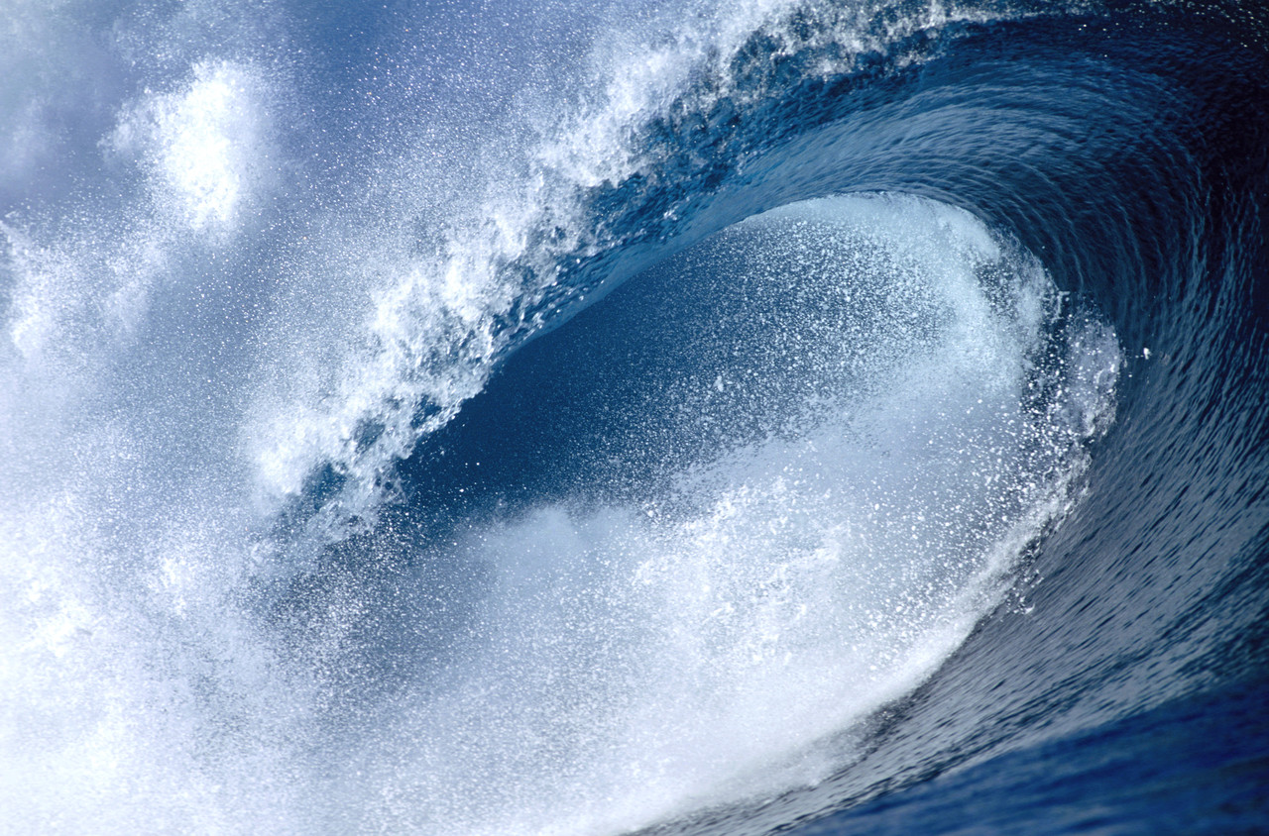
Waves and Wave Properties
Notes:
Presentation for lesson 2: Waves and Wave Properties, in the Waves: The Three Color Mystery unit
The slides are animated so you can click (space bar, mouse, etc.) to show the next item when the class is ready.

Slide 2
Why are we able to see?
Answer: Because there is light.
And…what is light?
Answer: Light is a wave.
So…what is a wave?

Slide 3
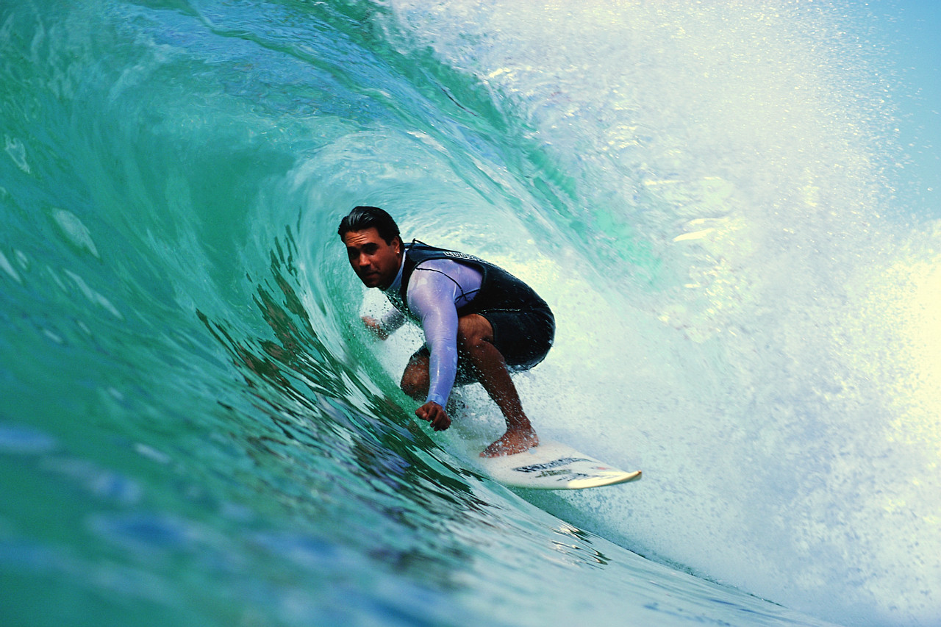
Answer: A wave is a disturbance that carries energy from place to place.
A wave does NOT carry matter with it! It just moves the matter as it goes through it.
Notes:
Think of a stadium wave: the people are moving up and down, but the wave goes around the stadium

Slide 4
Some waves do not need matter (called a “medium”) to be able to move (for example, through space).
These are called electromagnetic waves (or EM waves).
Some waves MUST have a medium in order to move. These are called mechanical waves.

Slide 5
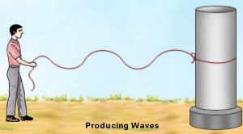
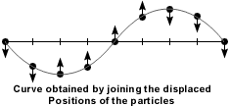
Wave Types
Transverse waves: Waves in which the medium moves at right angles to the direction of the wave

Slide 6
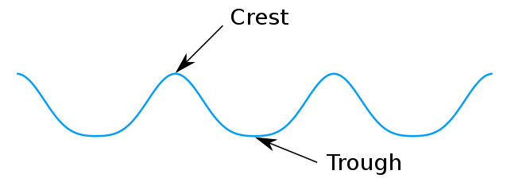
Parts of transverse waves:
Crest: the highest point of the wave
Trough: the lowest point of the wave

Slide 7
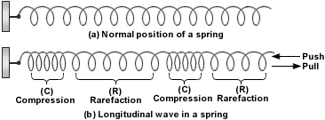
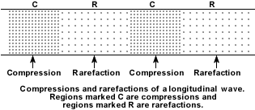
2. Compressional (or longitudinal) waves: Waves in which the medium moves back and forth in the same direction as the wave

Slide 8
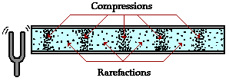
Parts of longitudinal waves:
Compression: where the particles are close together
Rarefaction: where the particles are spread apart

Slide 9
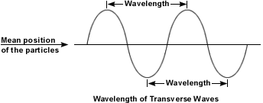
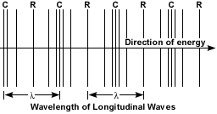
Wave Properties
Wave properties depend on what (type of energy) is making the waves.
Wavelength: The distance between one point on a wave and the exact same place on the next wave.

Slide 10
2. Frequency: How many waves go past a point in one second; unit of measurement is hertz (Hz).
The higher the frequency, the more energy in the wave.
10 waves going past in 1 second = 10 Hz
1,000 waves go past in 1 second = 1,000 Hz
1 million waves going past = 1 million Hz

Slide 11
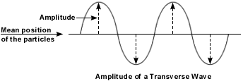
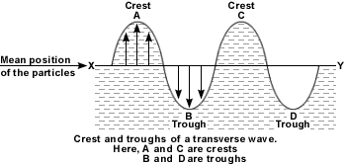
3. Amplitude: How far the medium moves from rest position (where it is when not moving).
Remember that for transverse waves, the highest point is the crest, and the lowest point is the trough.

Slide 12
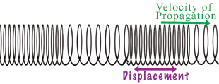
Remember that for compressional waves, the points where the medium is close together are called compressions and the areas where the medium is spread apart are called rarefactions.
The closer together and further apart the particles are, the larger the amplitude.
compression
rarefaction

Slide 13
The energy of a wave is proportional to the square of its amplitude. Mathematically speaking . . .
E = CA²
Where:
E = energy (the capacity to do work)
C = a constant (depends on the medium)
A = amplitude
For example:
If the amplitude is equal to 3 units
(and we assume C = 1 for this case) . . .
E = (1) (3)² = (1) (9) = 9 units

Slide 14
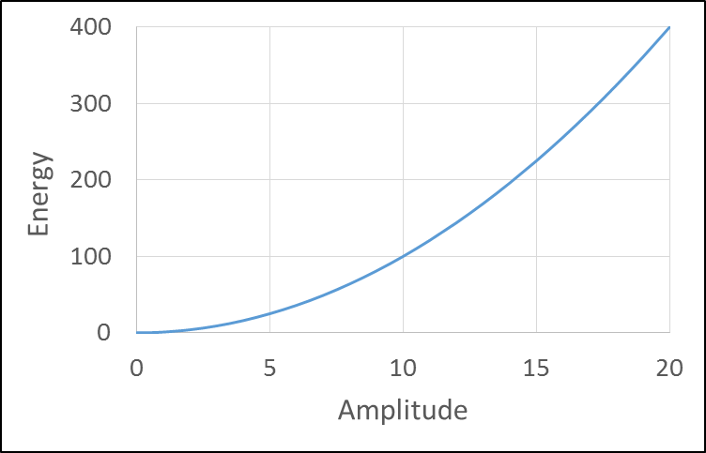
Note that when the amplitude of a wave is one unit, the energy is one unit.
When the amplitude is doubled, the energy is quadrupled.
When the energy is 10 times greater, the energy is 100 times greater!
Amplitude | Energy
1 | 1
2 | 4
3 | 9
4 | 16
5 | 25
6 | 36
7 | 49
8 | 64
9 | 81
10 | 100
E = CA²

Slide 15
4. Wave speed: Depends on the medium in which the wave is traveling. It varies in solids, liquids and gases.
A mathematical way to calculate speed:
wave speed = wavelength x frequency
(in meters)
(in Hz)
OR
v = f x ג
Problem: If a wave has a wavelength of 2 m and a frequency of 500 Hz, what is its speed?
Notes:
Answer: speed = 2 m x 500 Hz = 1000 m/s

Slide 16
Answer: speed = 2 m x 500 Hz = 1000 m/s
Changing Wave Direction
Reflection: When waves bounce off a surface.
If the surface is flat, the angle at which the wave hits the surface will be the same as the angle at which it leaves the surface (angle in = angle out).
This is the law of reflection.
Notes:
For example, think of a pool ball striking the side of the pool table: The angle it hits the side is the same angle it bounces off the side.

Slide 17
2. Refraction: Waves can bend.
This happens when a wave enters a new medium and its SPEED CHANGES.
The amount of bending depends on the medium it is entering.

Slide 18
3. Diffraction: The bending of waves AROUND an object.
The amount of bending depends on the size of the obstacle and the size of the waves.
Large obstacle, small wavelength = low diffraction
Small obstacle, large wavelength = large diffraction

Slide 19
Image Sources
2004 Microsoft Corporation, One Microsoft Way, Redmond, WA 98052-6399 USA. All rights reserved.
Denise W. Carlson. Used with permission.
Tom Henderson, The Physics Classroom http://www.mwit.ac.th/~physicslab/applet_04/physics_classroom/Class/sound/u11l1c.html
Kraalennest, Wikipedia http://en.wikipedia.org/wiki/File:Crest_trough.svg

